Slide 1







Team Name : FutureForge
Project Title : GreenCommute

Slide 2
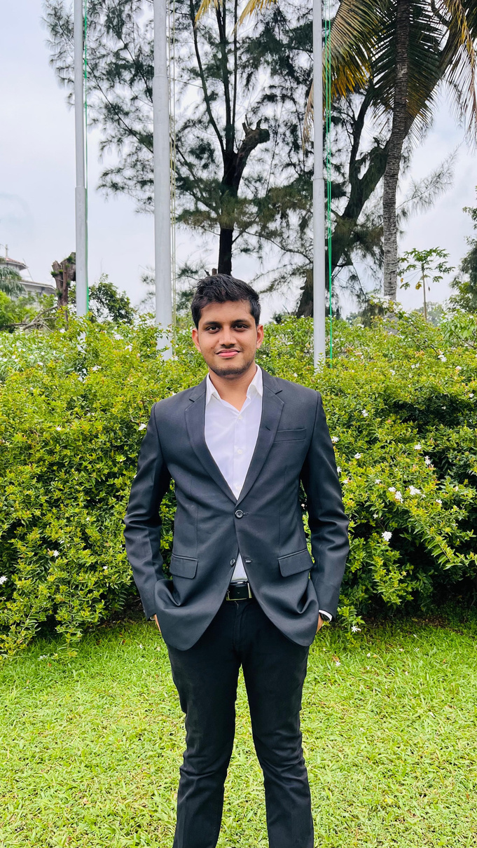


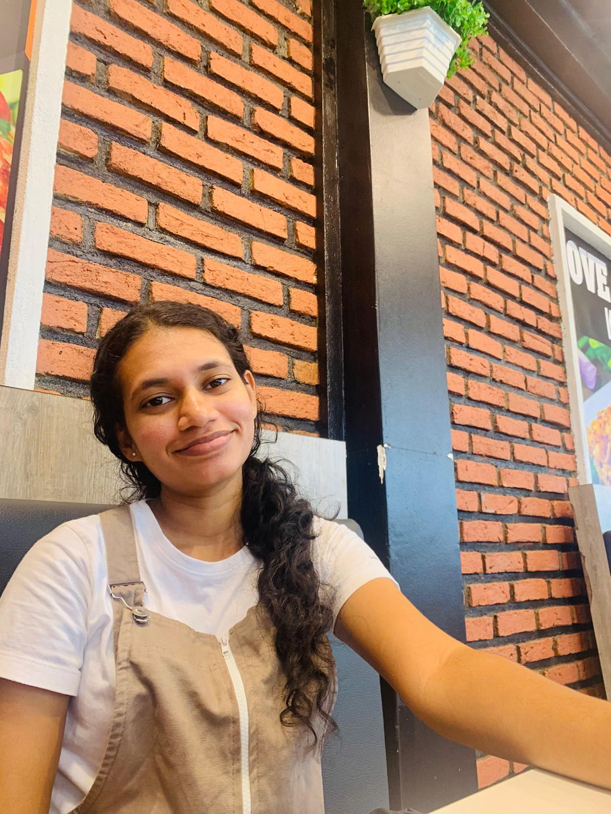
University Name : Wayamba University of Sri Lanka
Team Leader Name : Wihanga Senadheera
Team Members :
Team Introduction
P.W.N. Senadheera
M.A.N. Asma
V.P.K. Ashindi
K.K.G. Amarasinghe

Slide 3
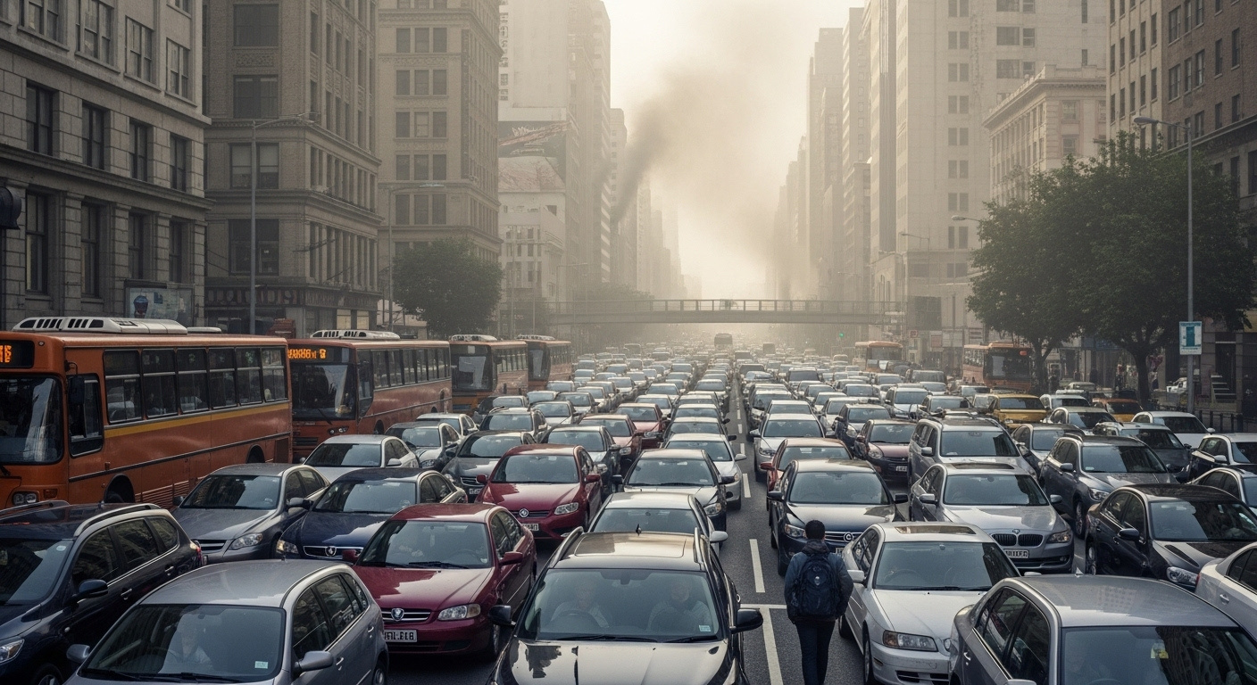
In many urban cities, traffic congestion, rising emissions, and over dependence on private transport have become serious challenges. Public transport systems are underutilized, and people lack real time, eco prioritized navigation options. As a result:
Commuters waste 50+ hours/year in traffic
Transport contributes to 30% of CO₂ emissions globally
Economic losses exceed billions annually
Despite existing navigation apps, users are not incentivized to choose sustainable travel. Cities continue to suffer from congestion and air pollution, especially during peak hours.
Problem Statement

Slide 4

Primary SDG Focus:
SDG 11 – Sustainable Cities and Communities
How it aligns:
Promotes greener, more inclusive urban transportation
Encourages public transport and cycling
Reduces traffic congestion and pollution
Focused SDG and How this SDG was effected

Slide 5


Focused SDG and How this SDG was effected
Secondary SDGs:
SDG 13 – Climate Action
SDG 9 – Industry, Innovation and Infrastructure

Slide 6
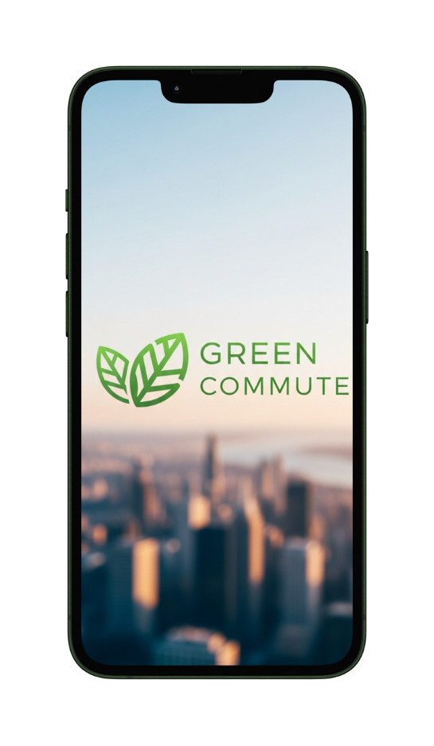
Title of the Solution: GreenCommute :
Smart Eco Mobility Navigator
Description:
GreenCommute is a mobile app that helps users reach their destinations through sustainable means like public transport, EV bikes, and walking while rewarding them for reducing emissions.
Core Technologies:
AI-based smart routing
Public transport and EV integration via APIs
Firebase backend and rewards system
Flutter for cross platform development
Proposed Solution and Technology Approaches

Slide 7





How it work
Multi-modal Navigation
EcoRewards System
Carbon Footprint Tracker
Seamless integration of buses, trains, bikes, and walking routes
Points for sustainable choices, redeemable for transit discounts
Real-time visualization of environmental impact by transport mode
Social Challenges
Live Data Integration
Community leaderboards and city-wide sustainability competitions
Pulls from traffic APIs, transport schedules

Slide 8
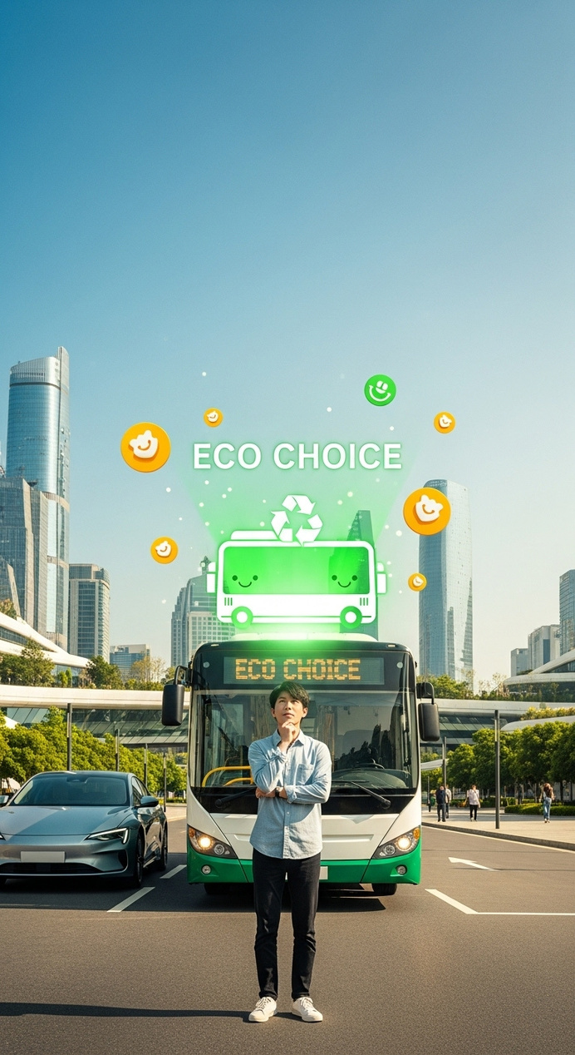
Innovation / Unique Value Proposition
Eco First Navigation: Prioritizes green transport over speed
Reward System: Gamified incentives for sustainable habits
Smart Suggestions: Based on location, time, and calendar
CO₂ Insights: Live carbon footprint tracking
Scalable Platform: Works across cities using modular APIs

Slide 9
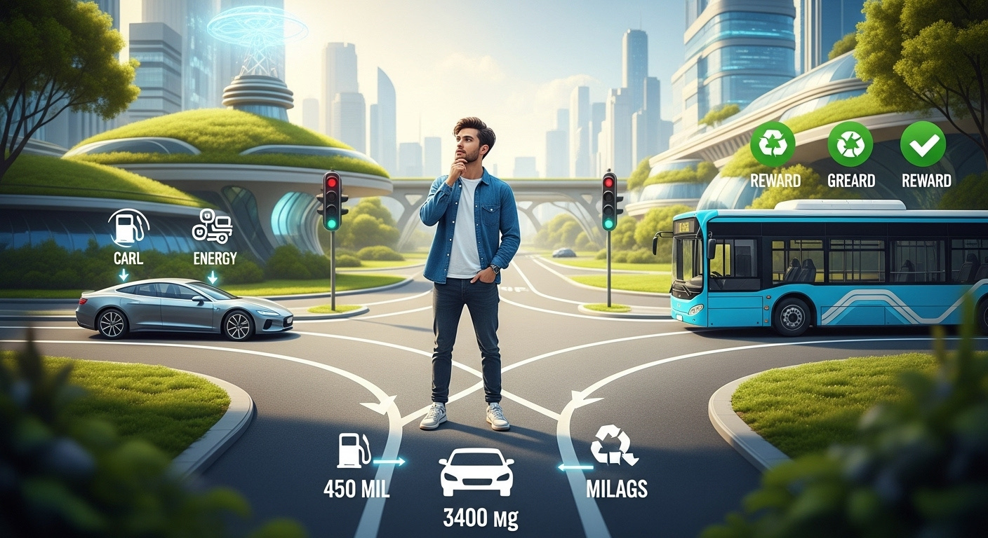
Impact Analysis
How it Solves the Problem:
Encourages shift from private vehicles to public/green transport
Creates awareness through rewards and impact tracking
Positive Impacts:
40% reduction in car trips per user
2.3 tons CO₂ saved per user annually
$1,200 saved on fuel & parking

Slide 10
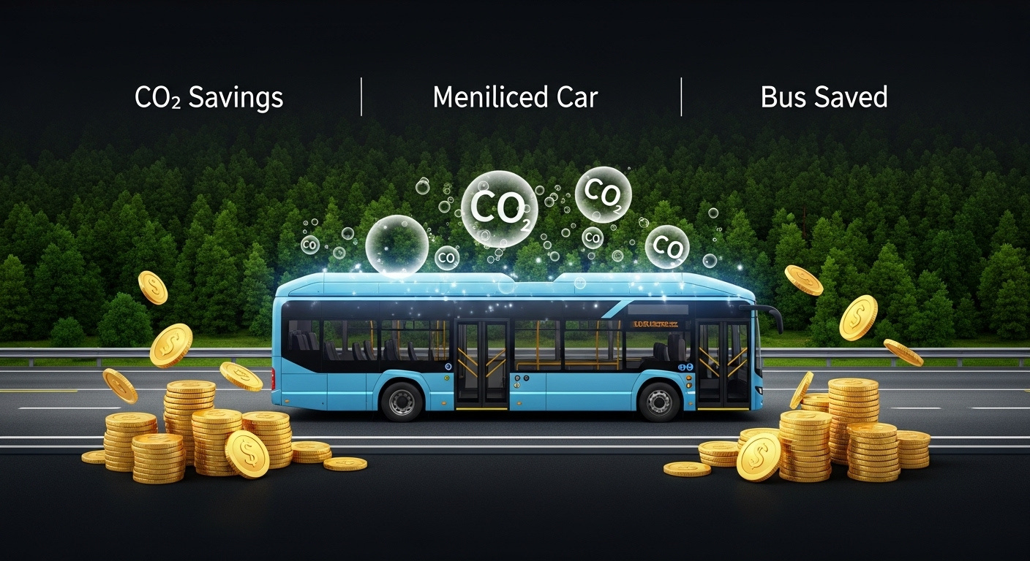
Impact Analysis
Risks & Limitations:
User resistance to change
Limited transport data in rural areas
GPS data dependency
Feasibility:
MVP can be built with open APIs, Flutter, Firebase
Modular backend for scaling

Slide 11

Resources & Timeline
Resources Needed:
Developer & UI/UX team
Transport data access
Firebase/hosting & analytics tools
Reward partnerships
Timeline:
Month 1: UI/UX + tech setup
Month 2–3: App development + testing
Month 4: Launch pilot + collect feedback

Slide 12
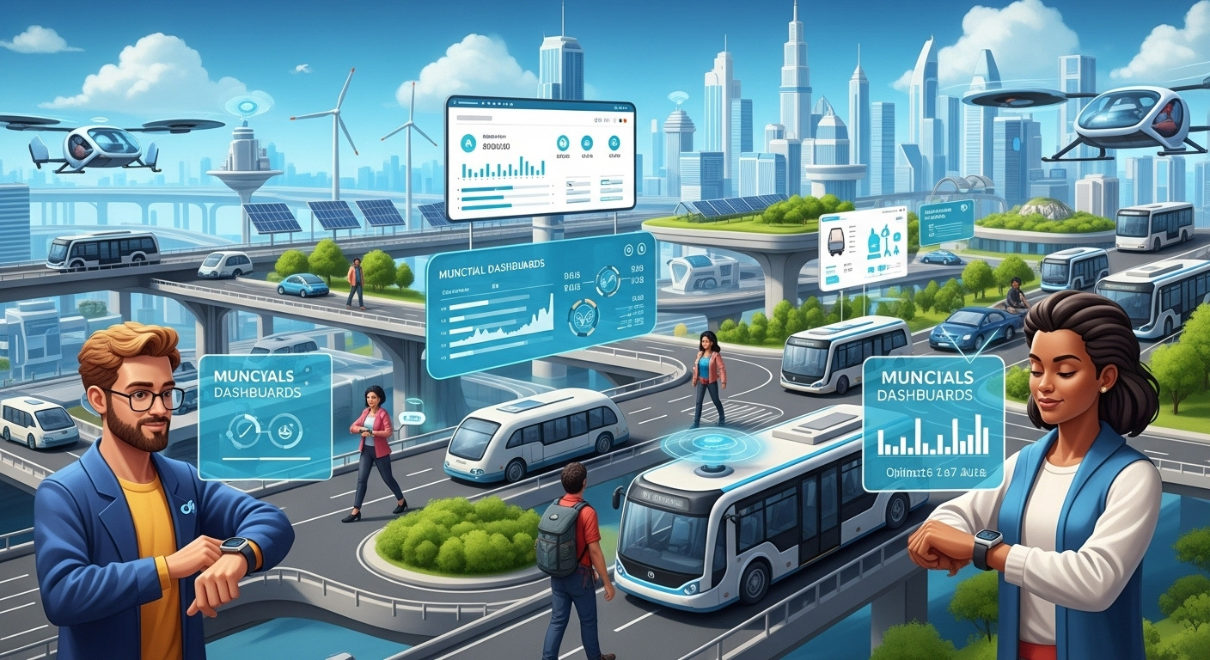
Future Plan & Improvements
User Testing Plan:
With students, daily commuters, eco-conscious users
Testing navigation accuracy, reward usability
Surveys and A/B tests
Future Extensions:
Multilingual support
Carbon offset integration
Municipal dashboard for city planning
Smartwatch sync for travel alerts

Slide 13
Prototype / Visuals

Slide 14
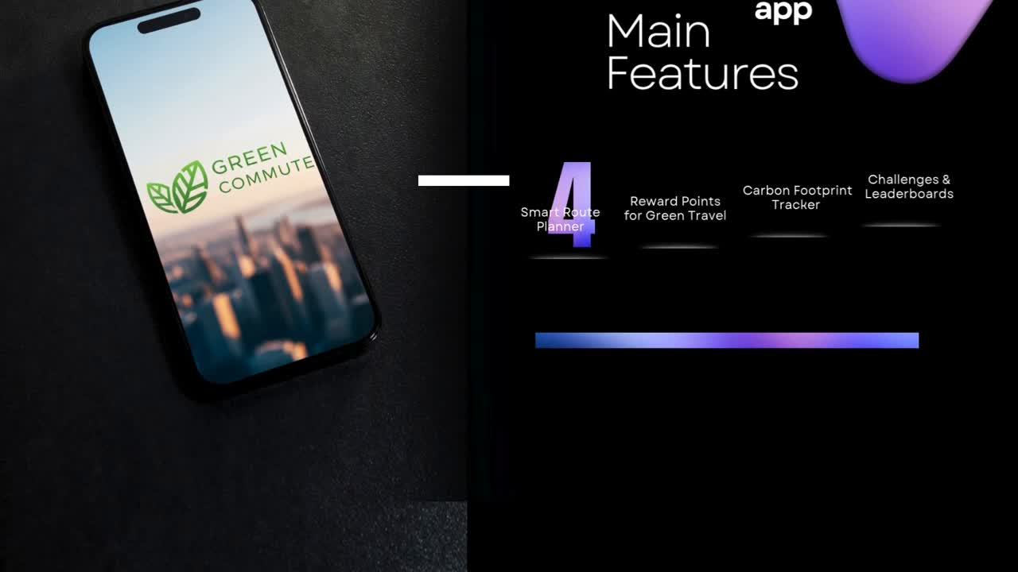

Slide 15


